Slide 1
LOCOMEDIA
Anthony Alvin 535200061
Mathew judianto 535200047
Zendi ibrahim 535200084
Melvin pramudita 535200060
Raihan Tara 535200046

Slide 2



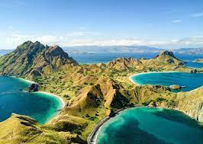
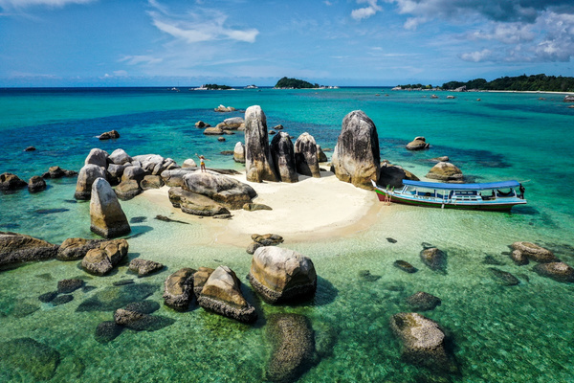
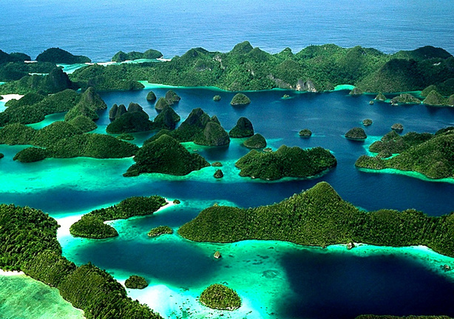
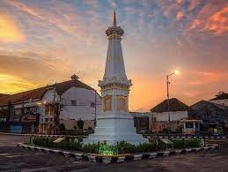
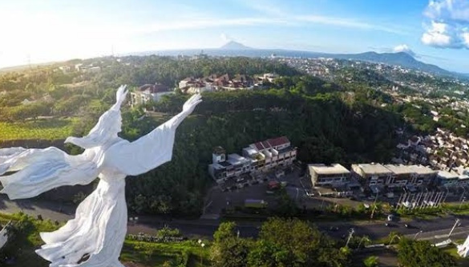
HOMEPAGE
LOCOMEDIA
Design pertama
BALI
NTT
BELITUNG
Bali is a province of Indonesia and the westernmost of the Lesser Sunda Islands
East Nusa Tenggara is the southernmost province of Indonesia. It comprises the eastern portion of the Lesser Sunda Islands
Belitung (or in English, Billiton) is an island on the east coast of Sumatra, Indonesia in the Java Sea.
PAPUA
JOGJAKARTA
SULAWESI UTARA
Papua, formerly Irian Jaya, is the largest and easternmost province of Indonesia
Dhaérah Istiméwa Yogyakarta) is a provincial-level autonomous region of Indonesia in the southern Java.
North Sulawesi (Indonesian: Sulawesi Utara) is a province of Indonesia. It is located on the Minahasa Peninsula of Sulawesi,

Slide 3
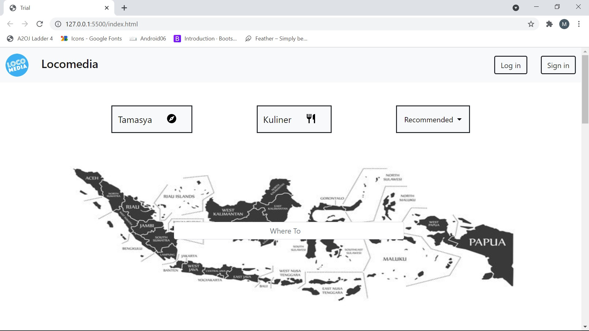
Homepage
Design kedua

Slide 4
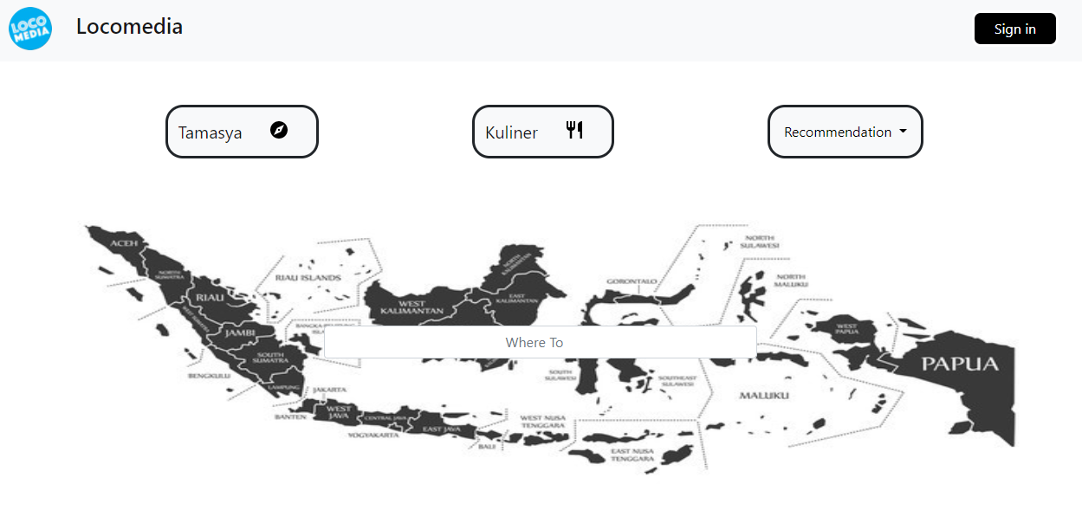
Homepage
Design Akhir

Slide 5
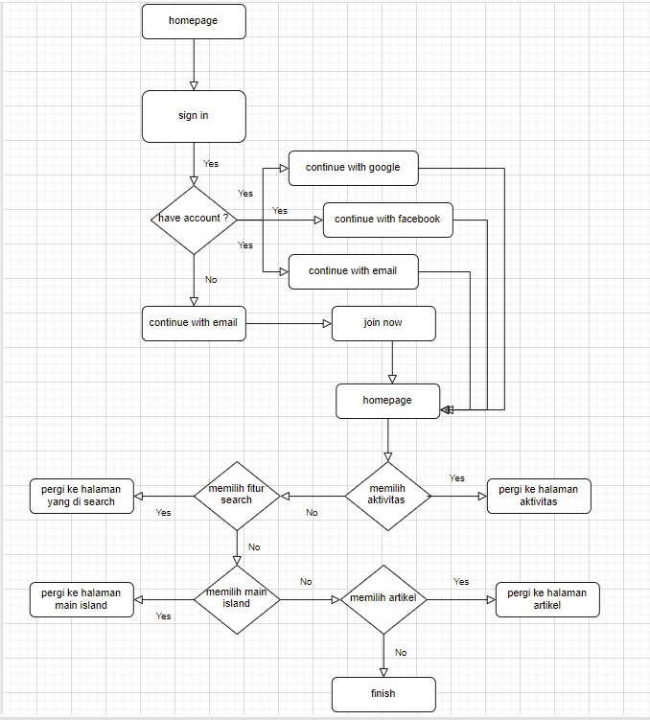
Flowchart homepage

Slide 6
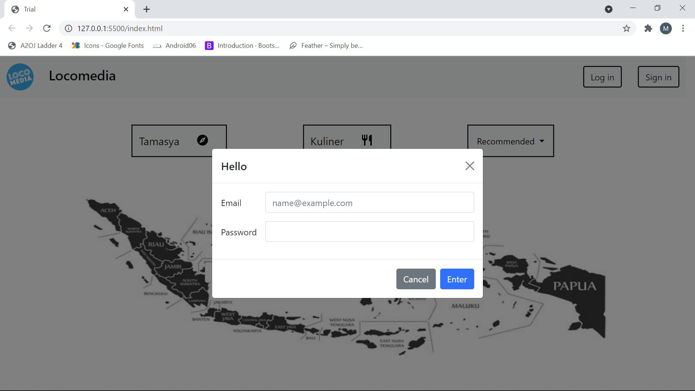
Login signin
Design kedua

Slide 7
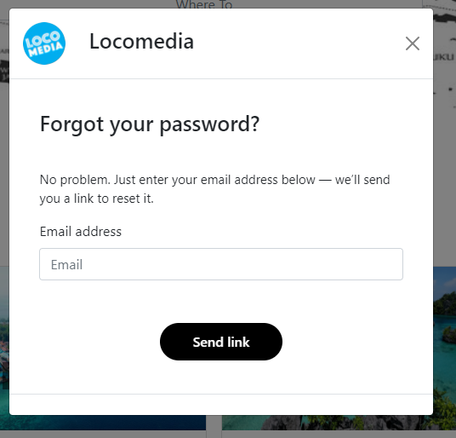
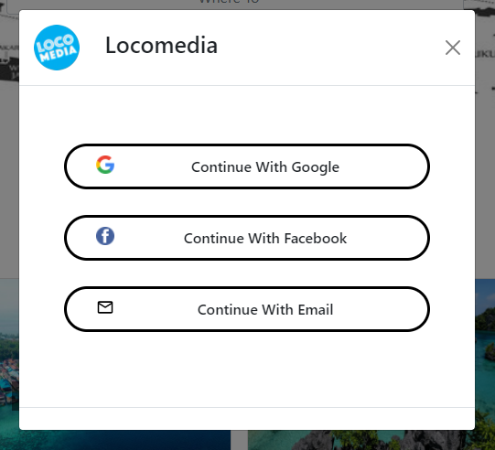
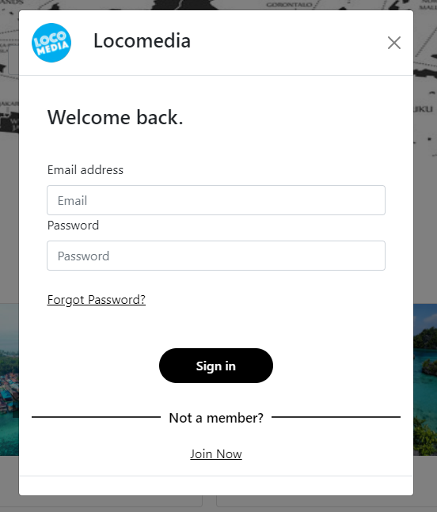
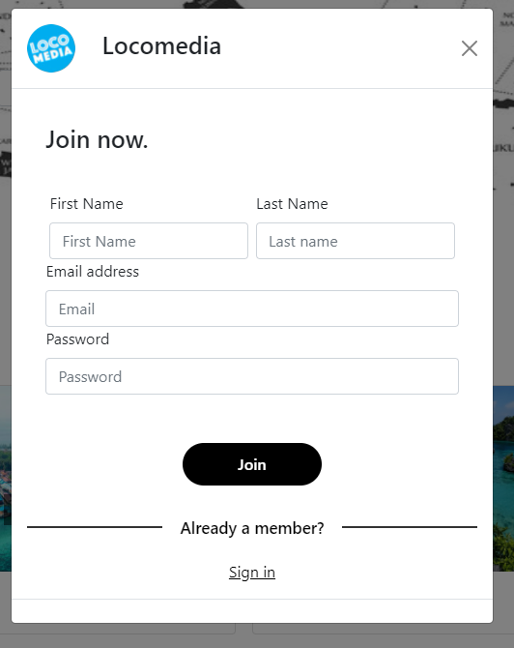
Sign in
Design Akhir

Slide 8
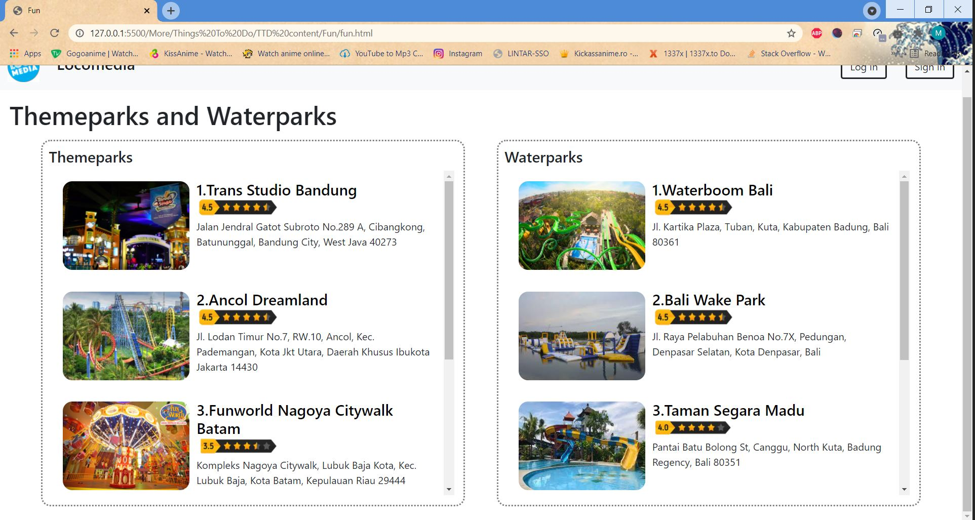
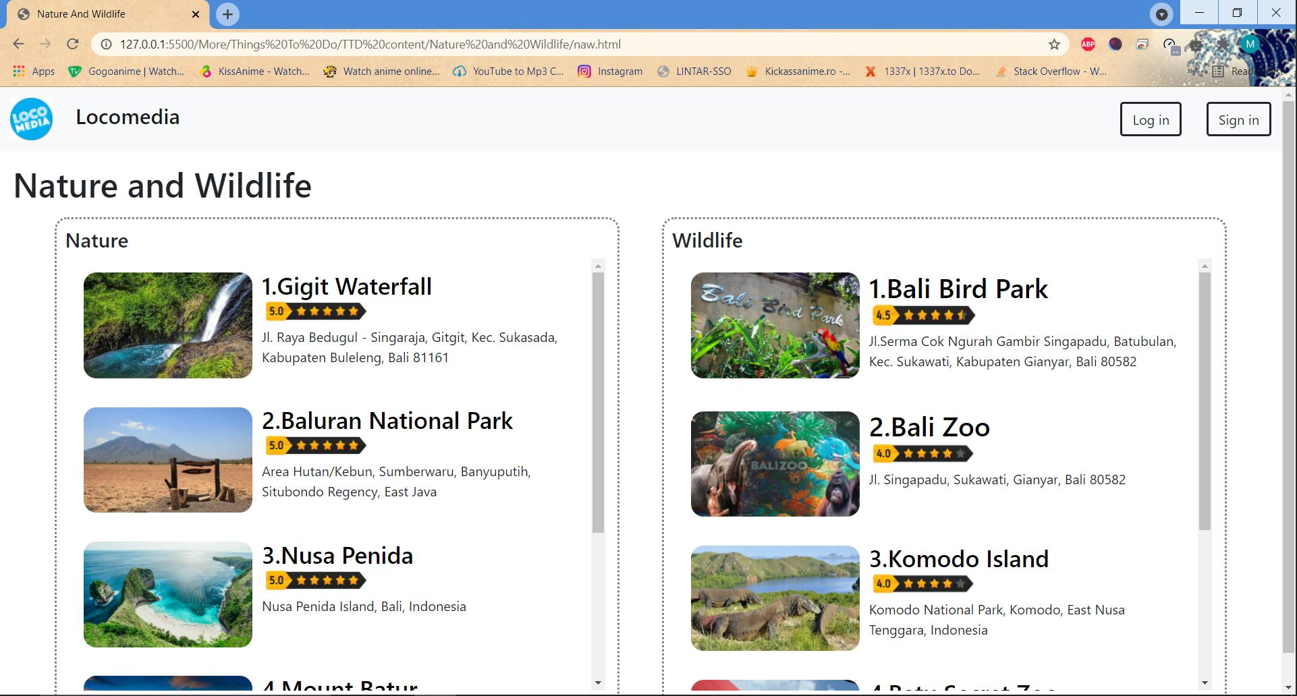
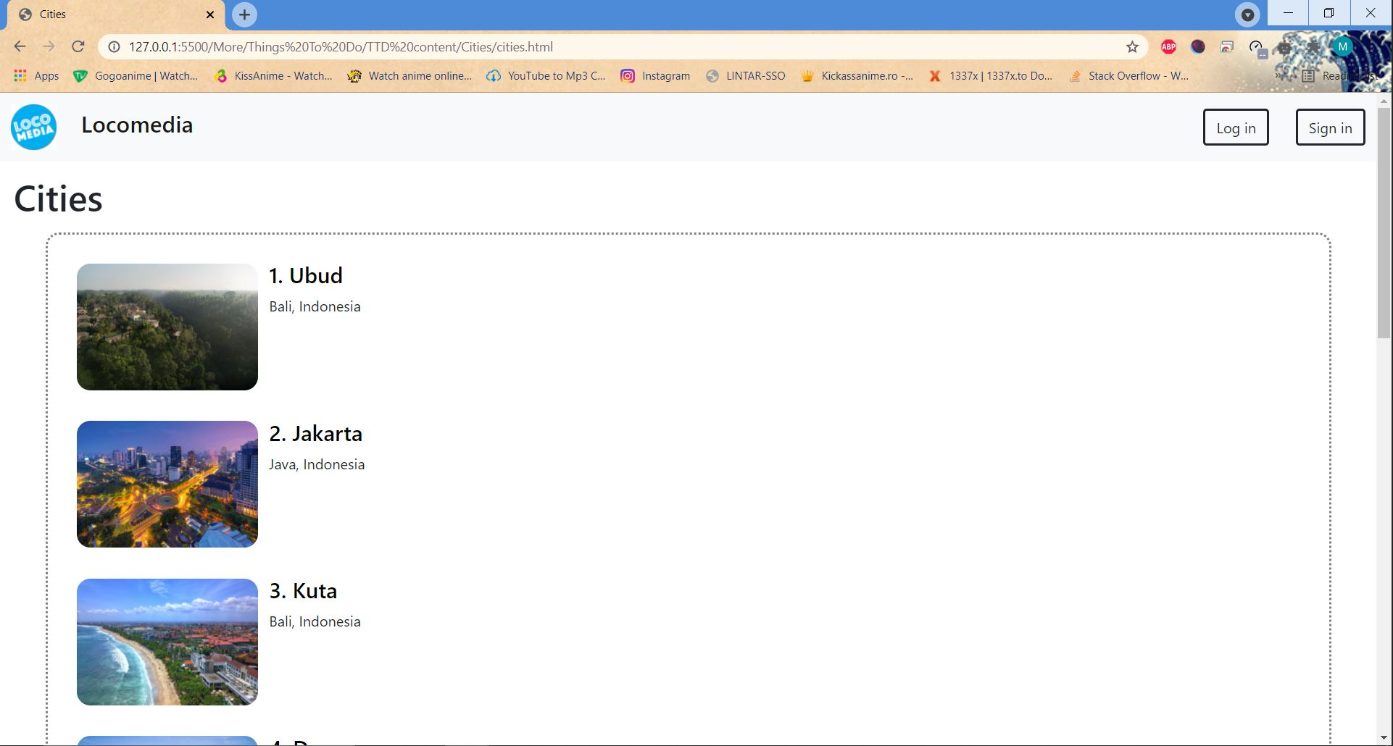
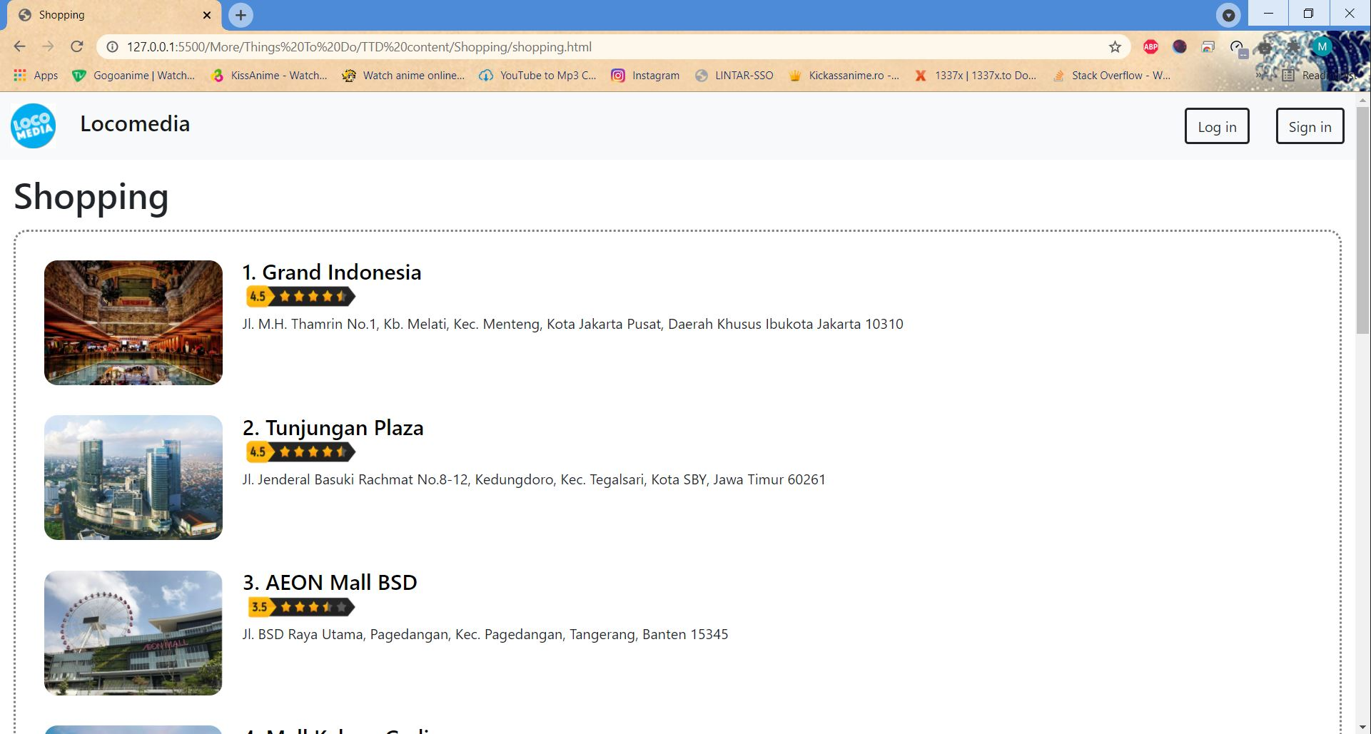
Recommended
Design kedua
Fun
Cities
Nature
Shopping

Slide 9
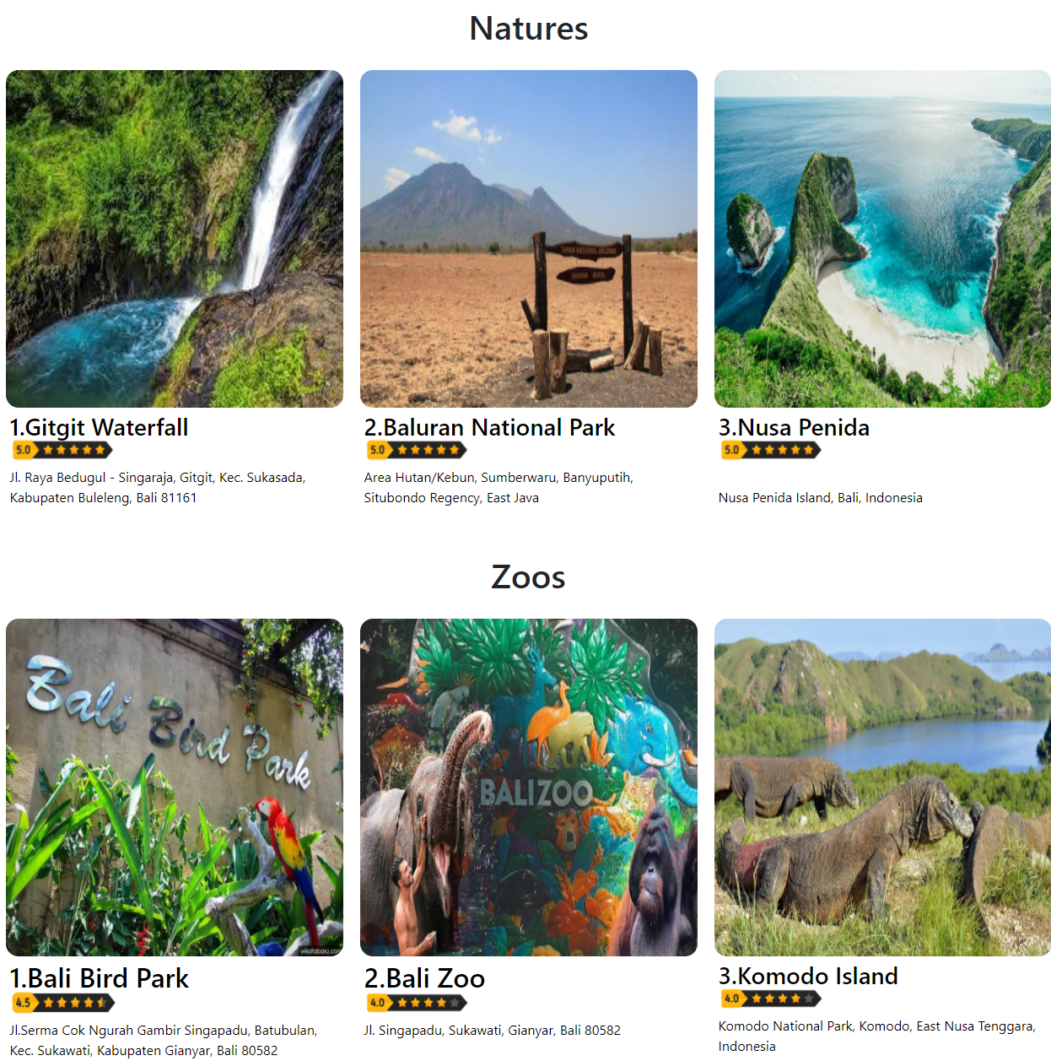
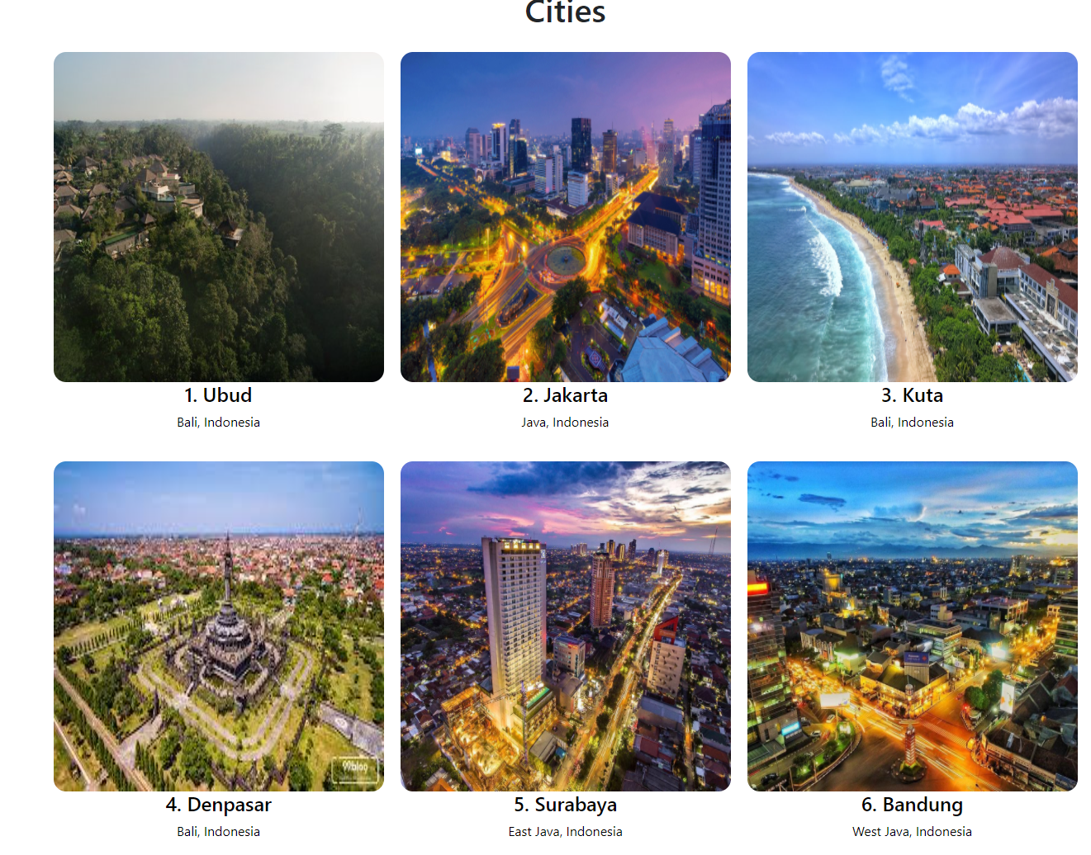
Recommend
Design Akhir

Slide 10
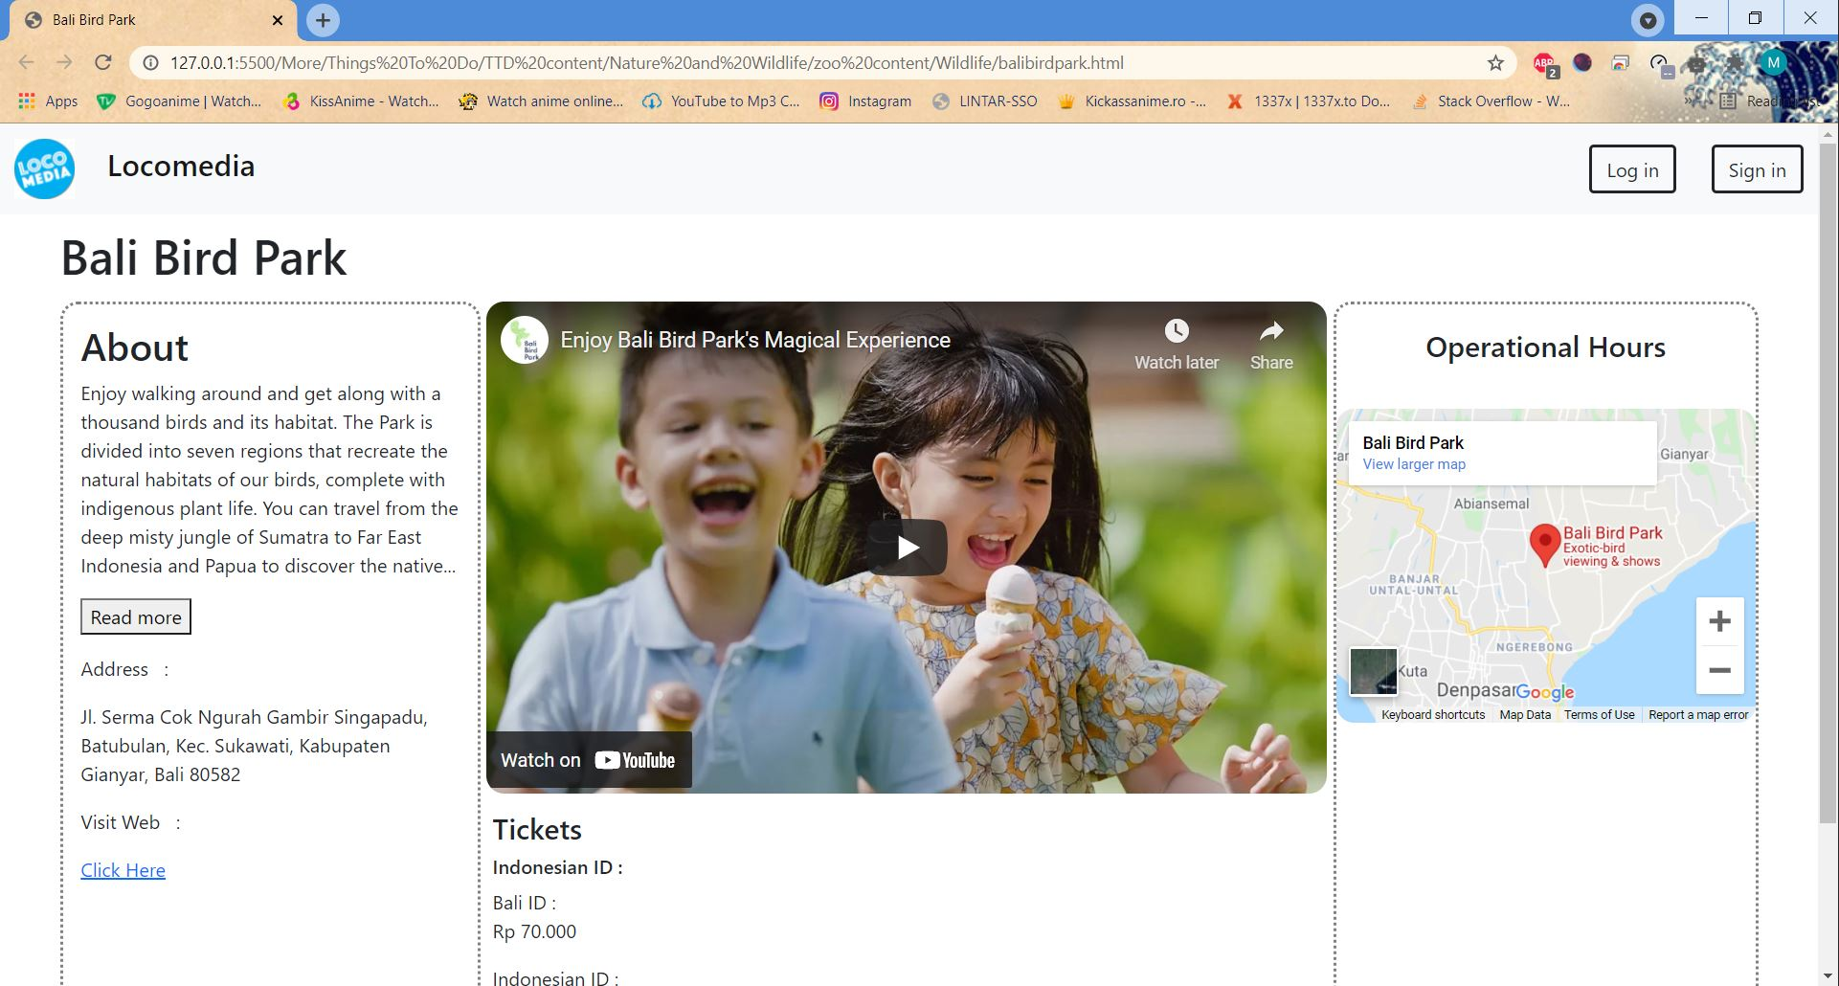
Contoh isi recommended
Design kedua

Slide 11
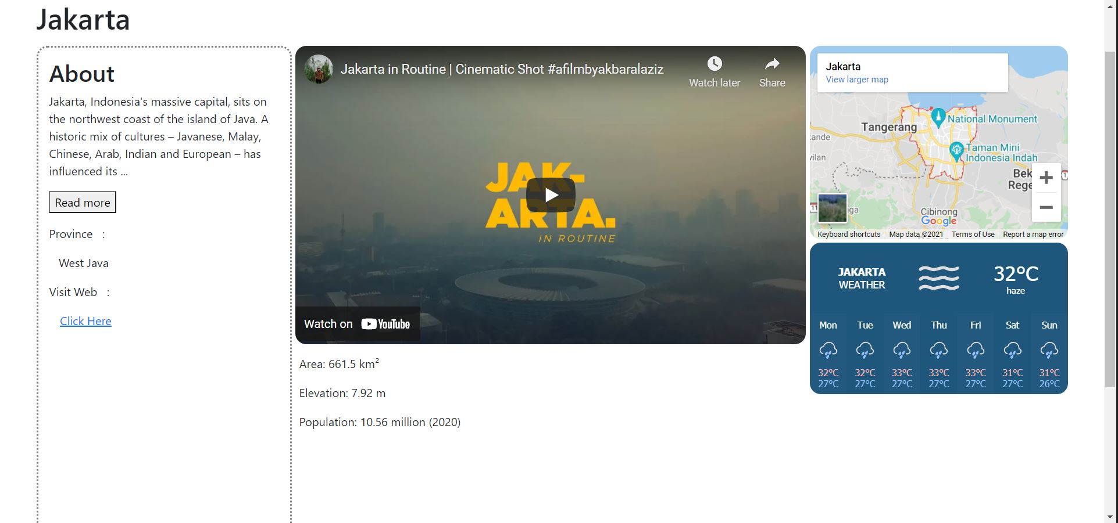
Contoh isi recommended
Design Akhir

Slide 12
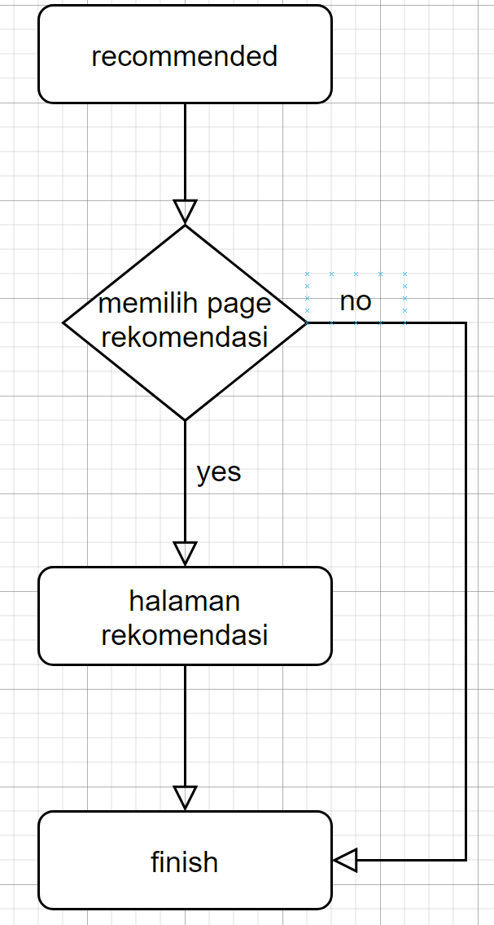
Flowchart recommended

Slide 13
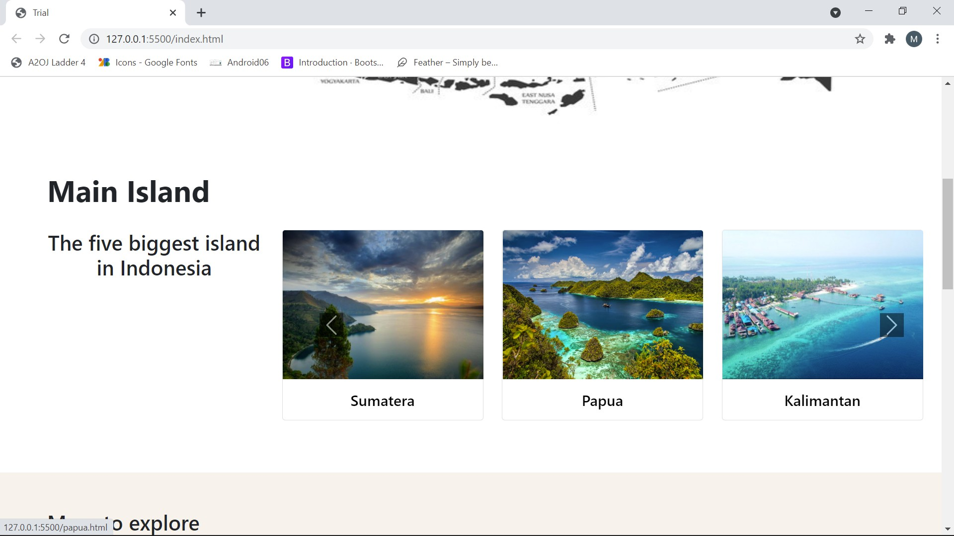
Main island
Design Akhir

Slide 14
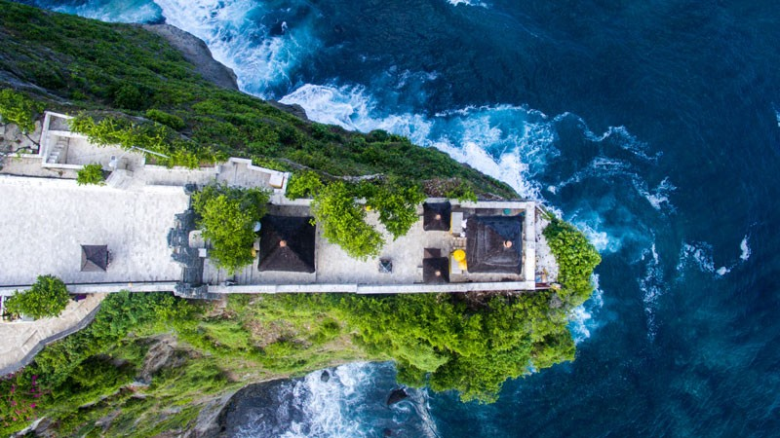
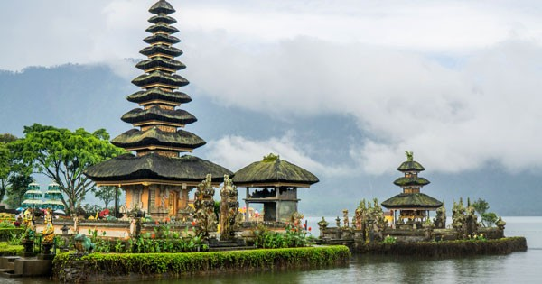

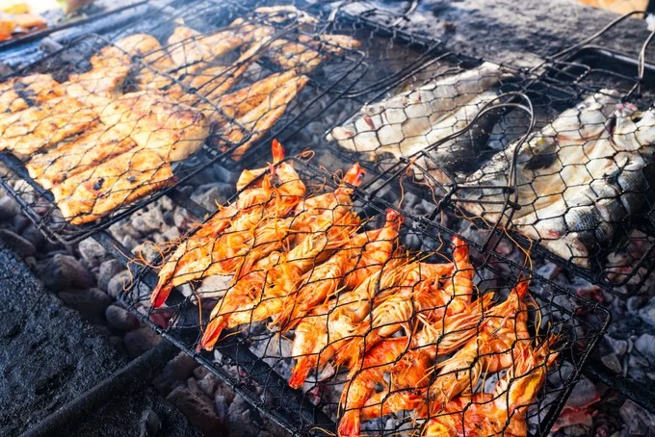

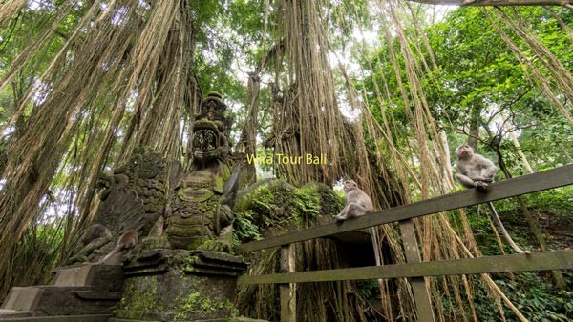

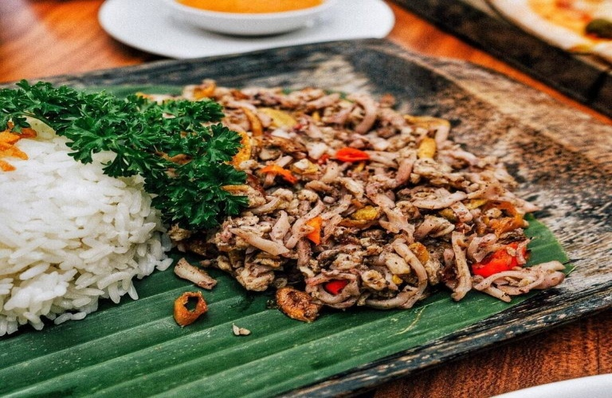
BALI
LOCOMEDIA
Design pertama
DESTINASI
KULINER
PURA ULUWATU
PURA ULUN DANU
AYAM BETUTU
SEAFOOD JIMBARAN
AIR TERJUN SEKUMPUL
UBUD MONKEY FOREST
JAJA BALI
LAWAR CUMIT

Slide 15
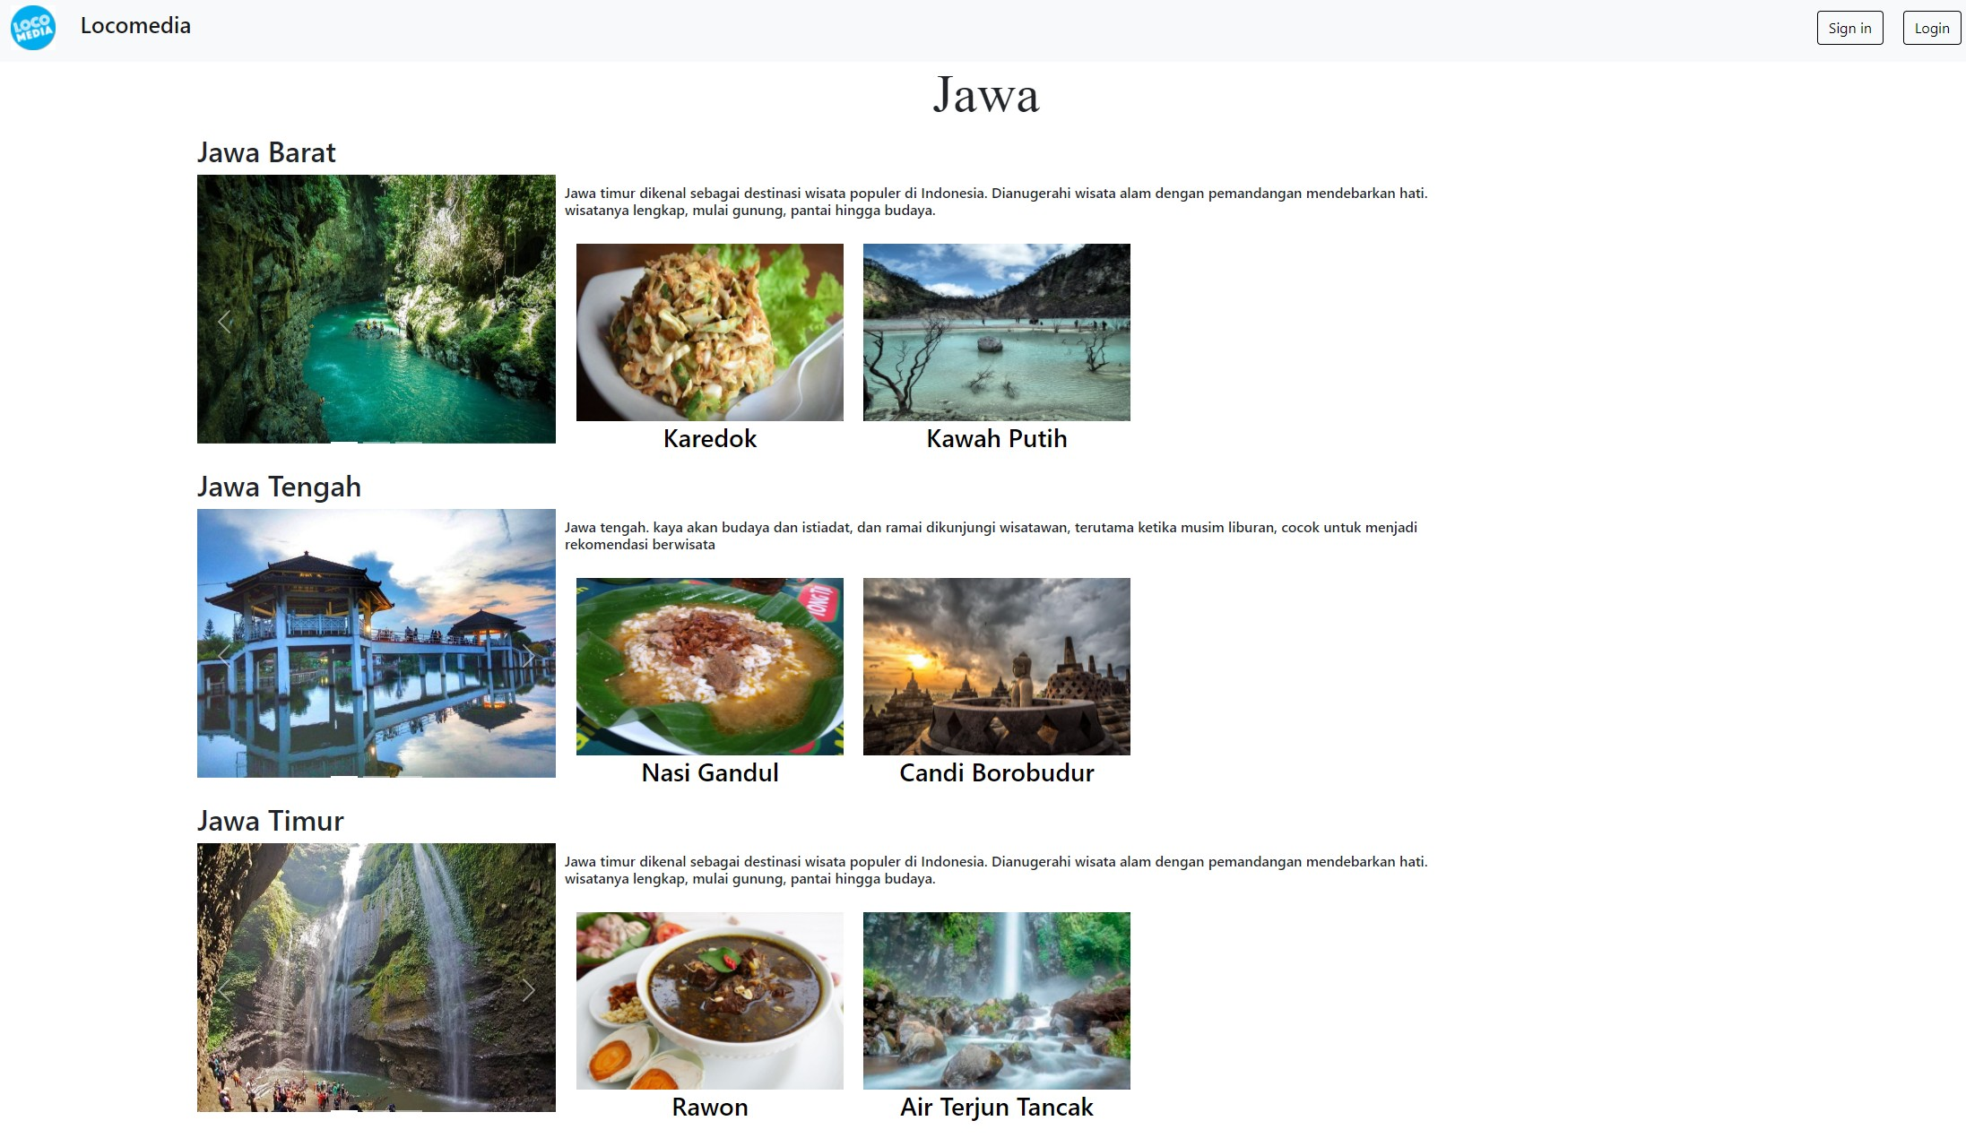
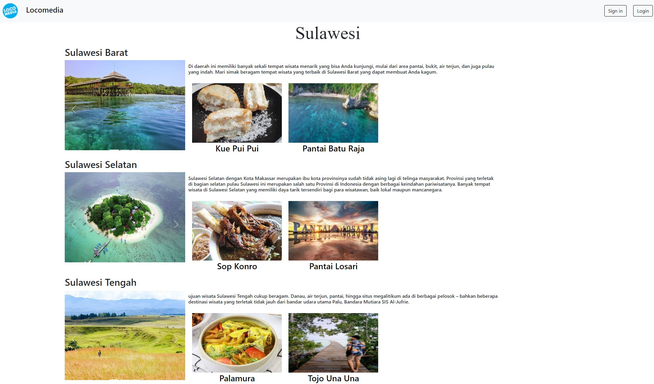
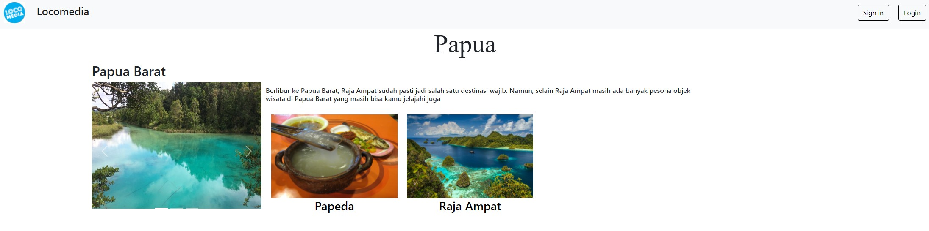
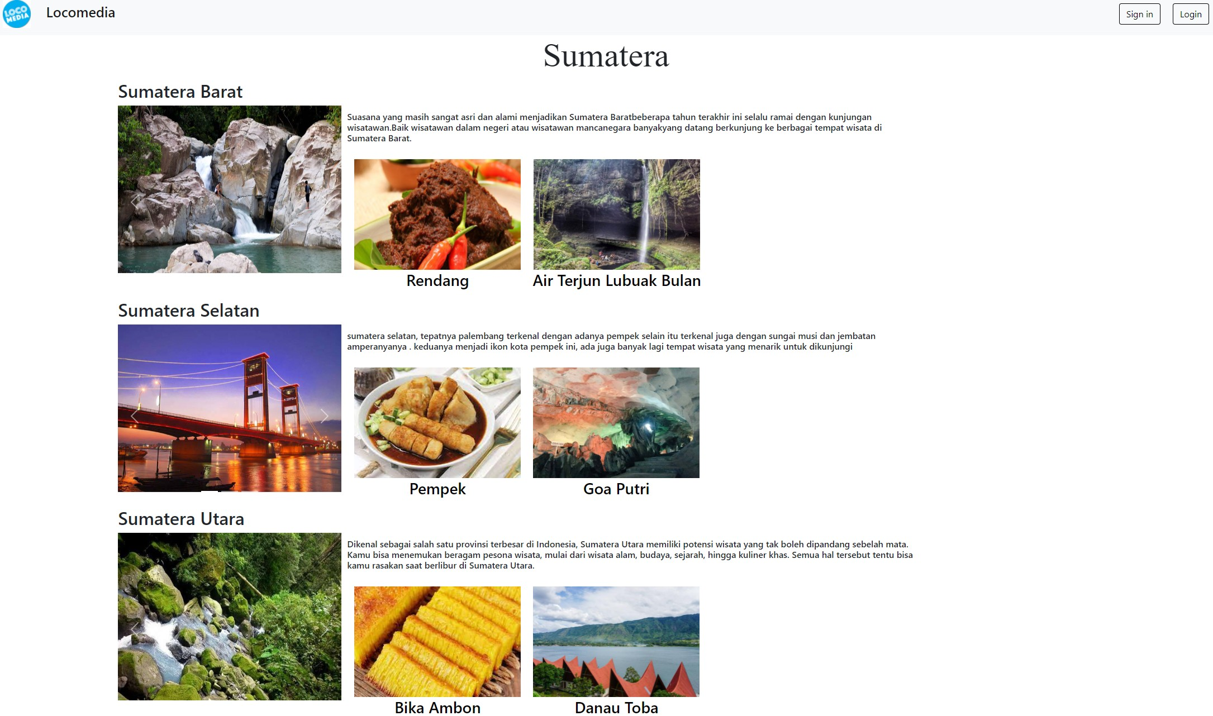
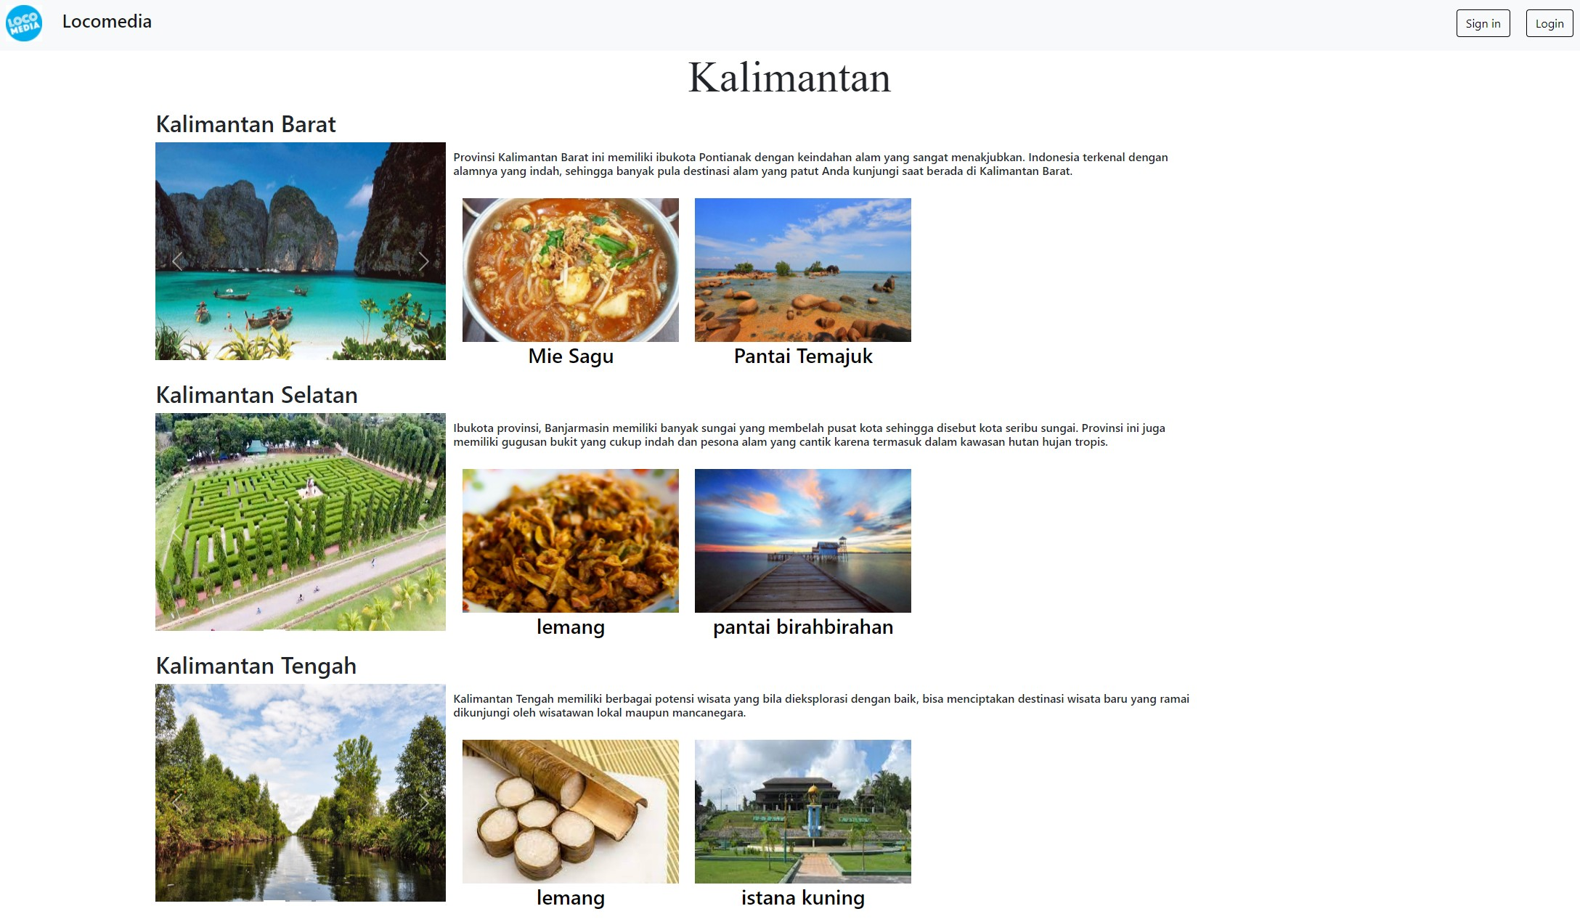
Main Island
Design kedua

Slide 16
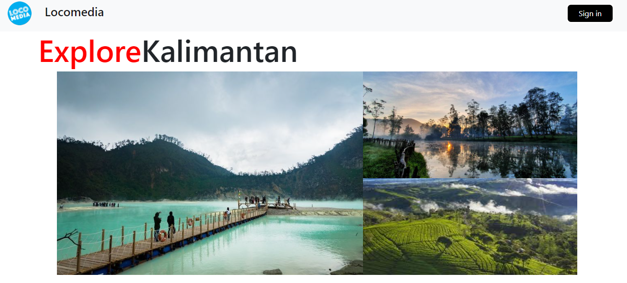
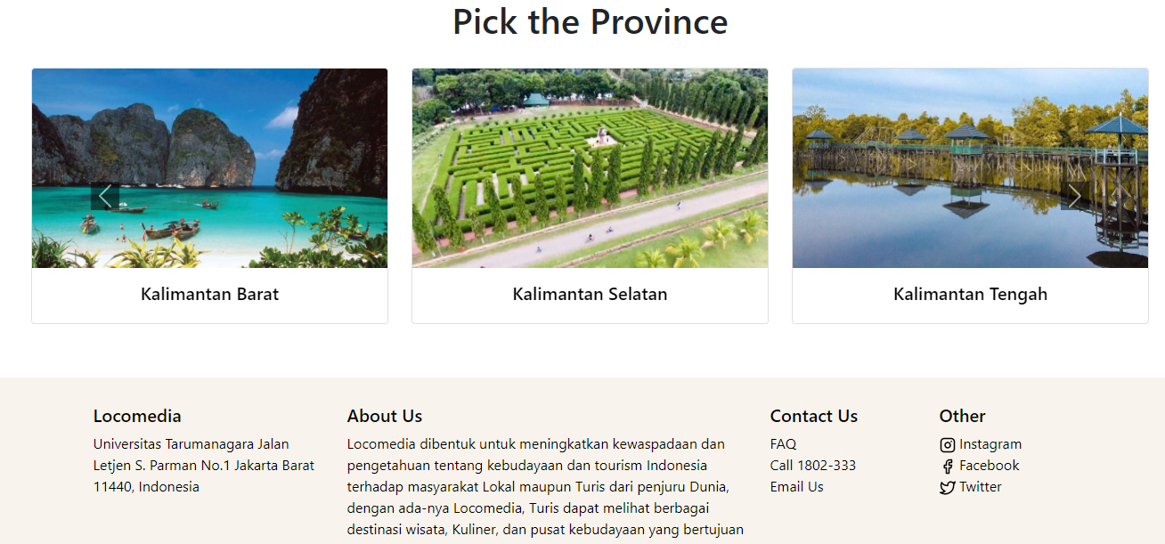
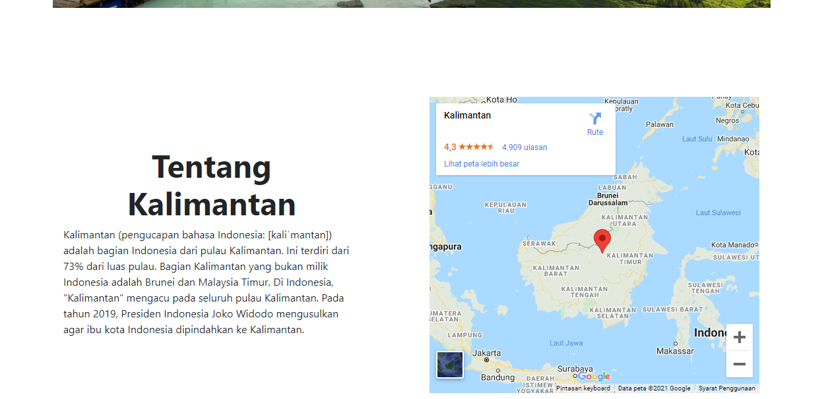
Main island
Design Akhir

Slide 17
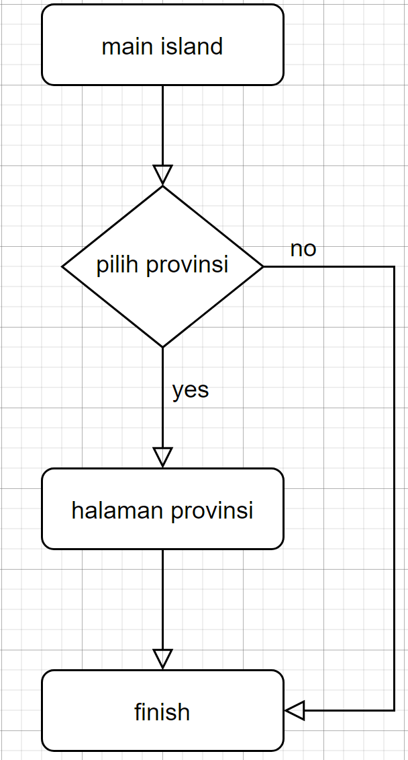
Flowchart main island

Slide 18
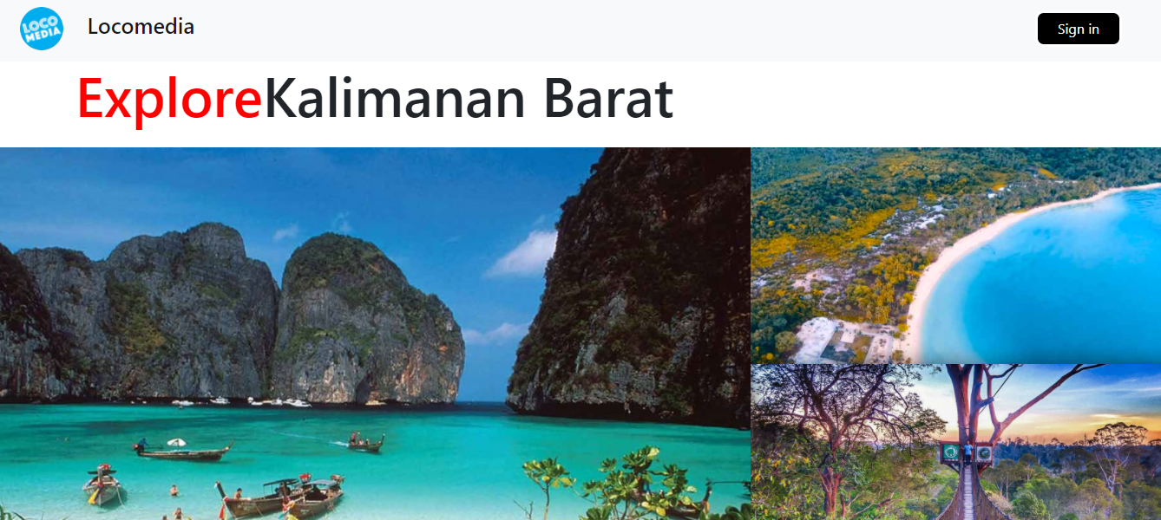
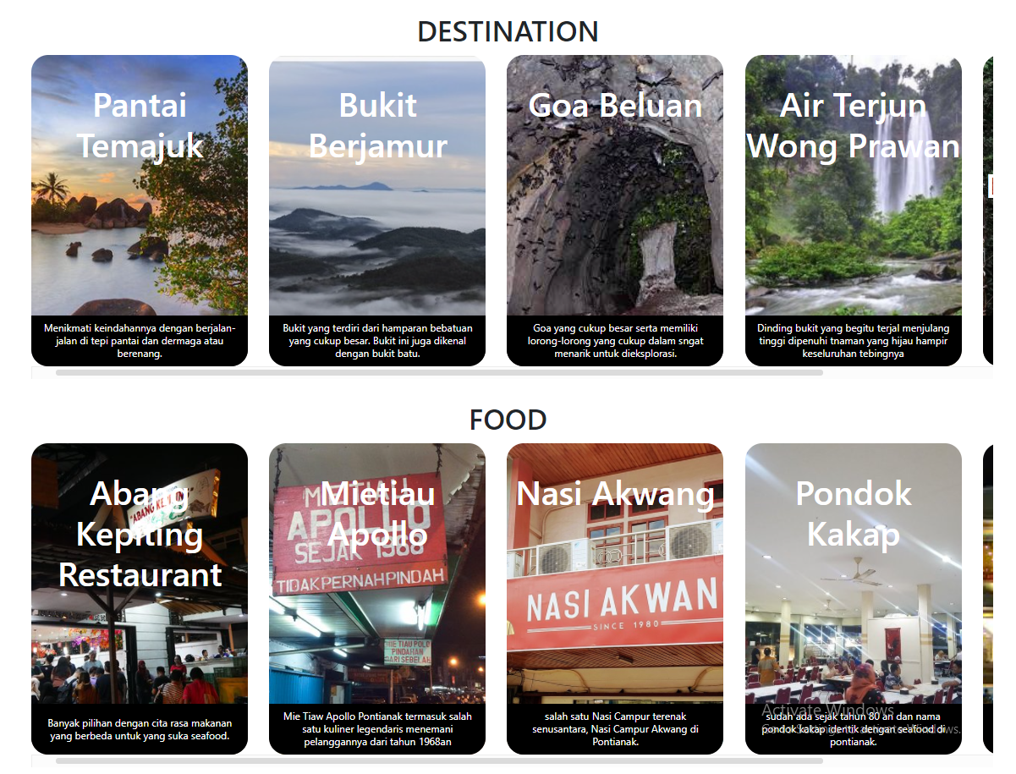
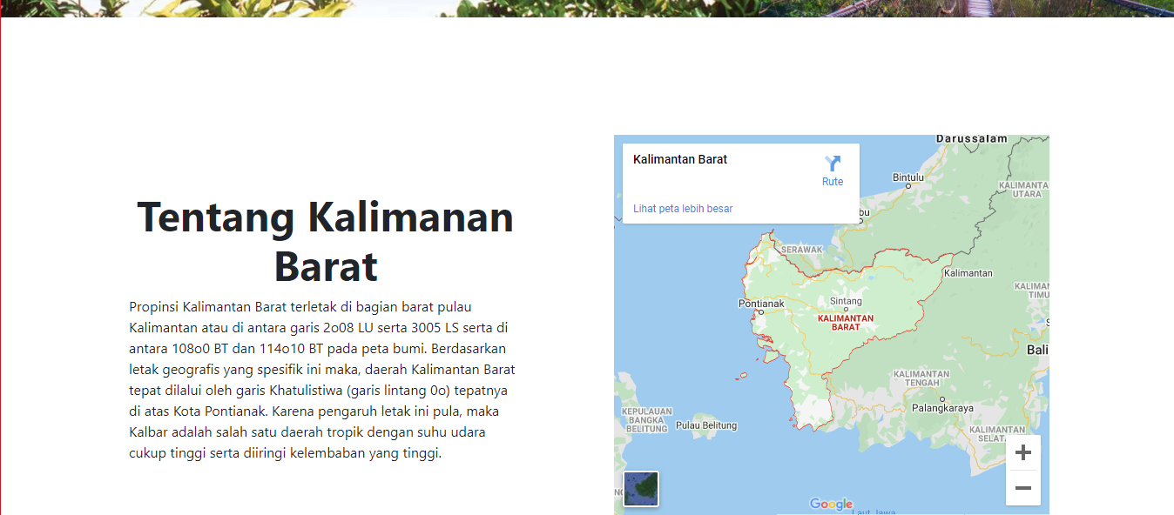
Pulau Kecil
Design Akhir

Slide 19
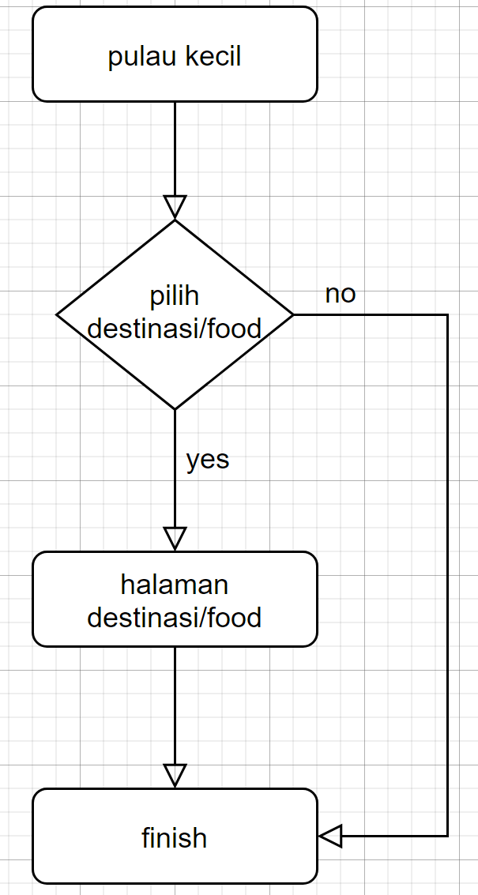
Flowchart pulau kecil

Slide 20
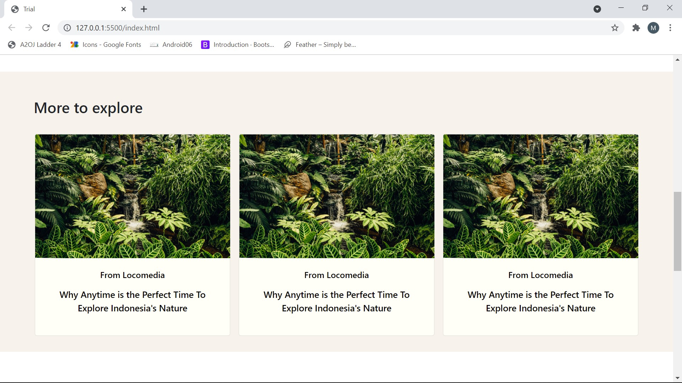
Artikel
Design kedua

Slide 21
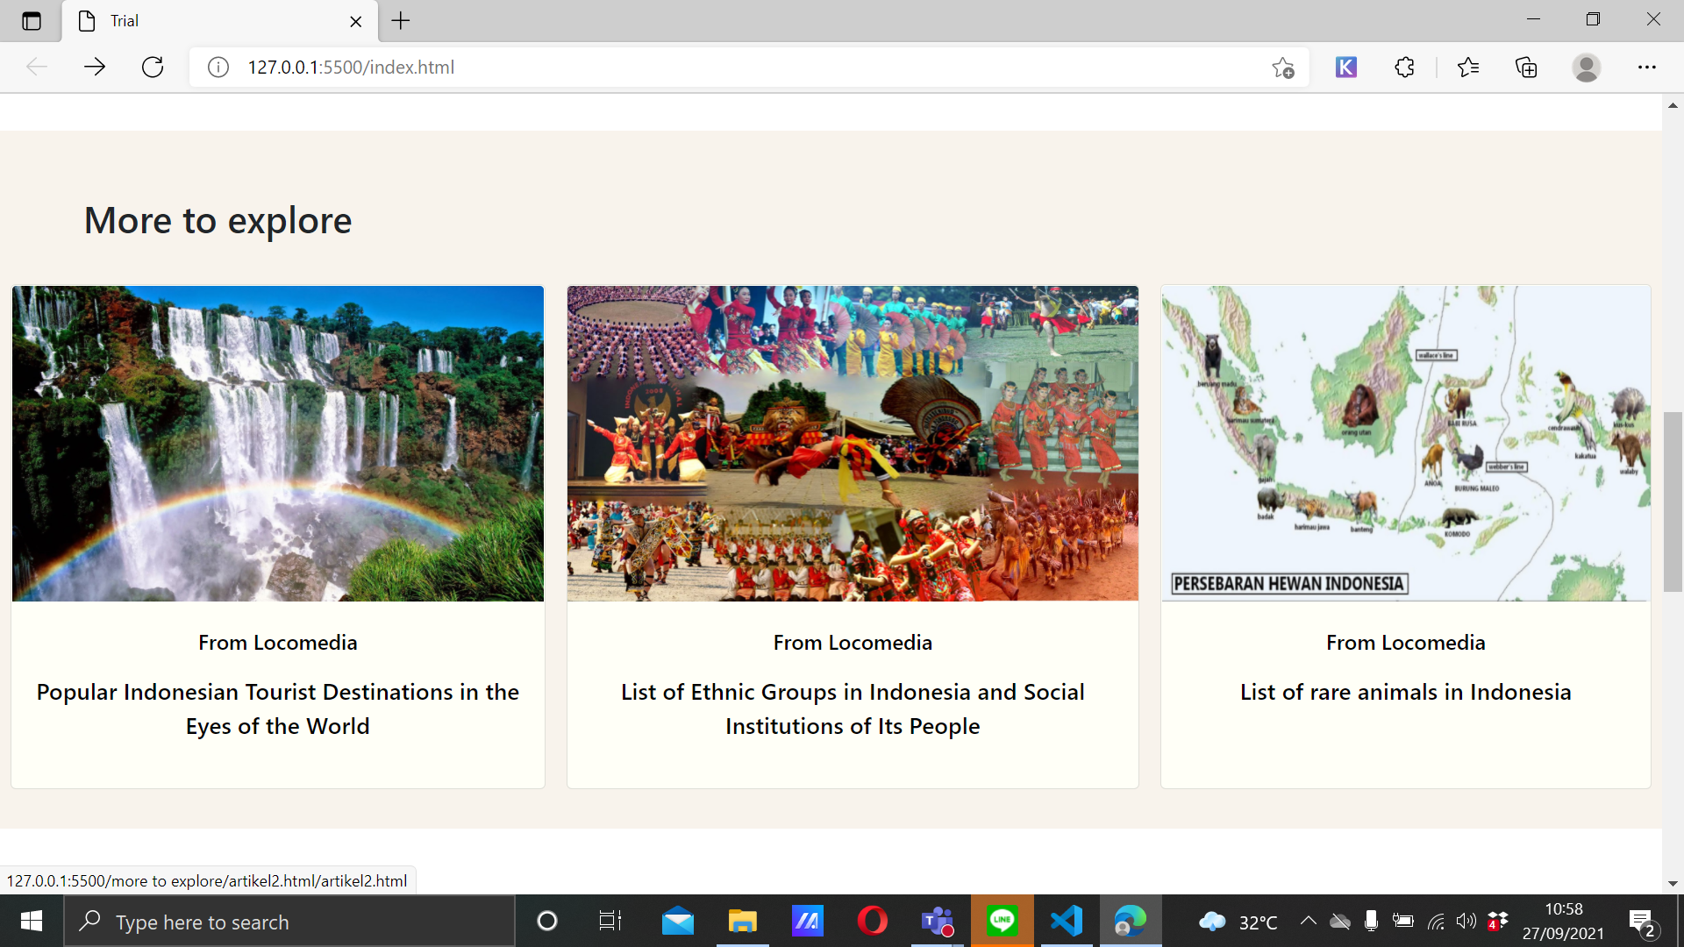
Artikel
Design Akhir

Slide 22
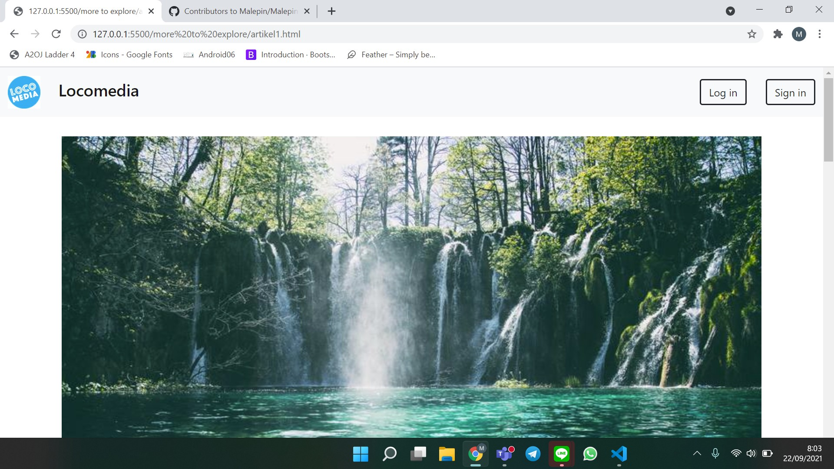
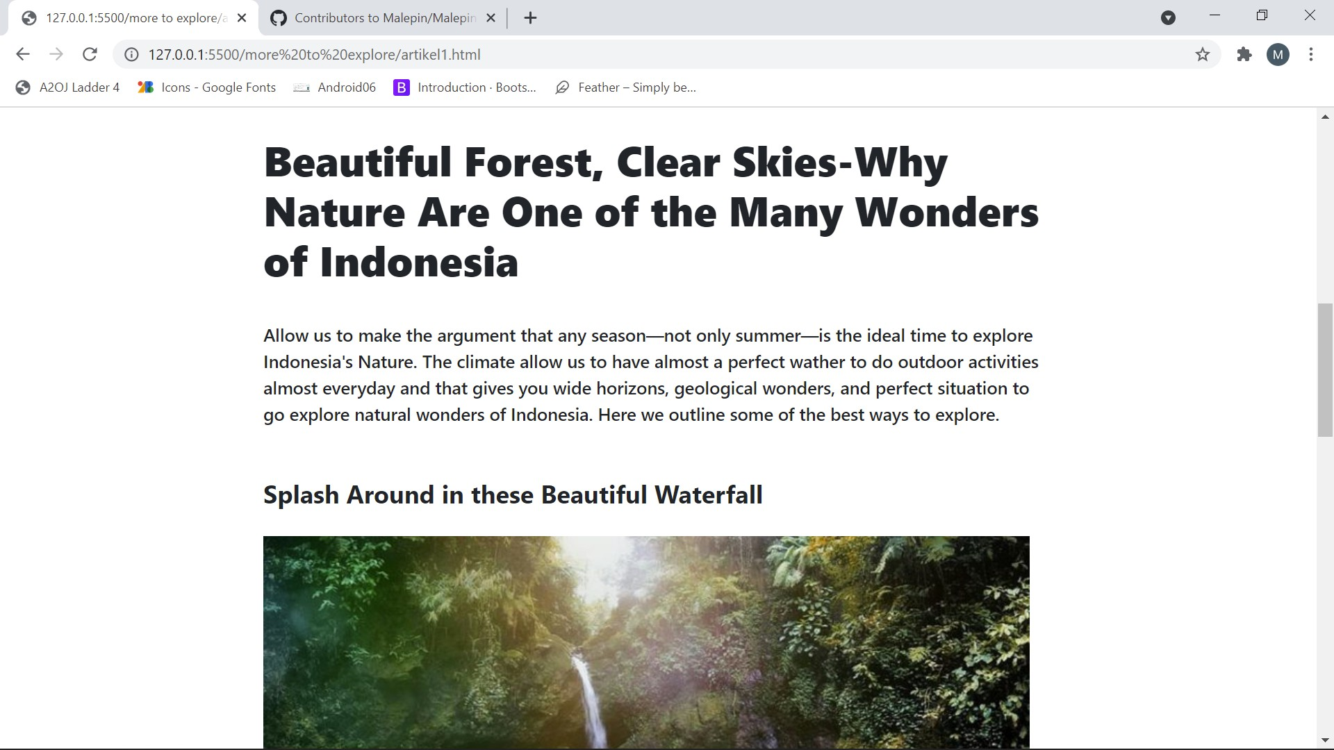
Header & title artikel
Design Akhir

Slide 23
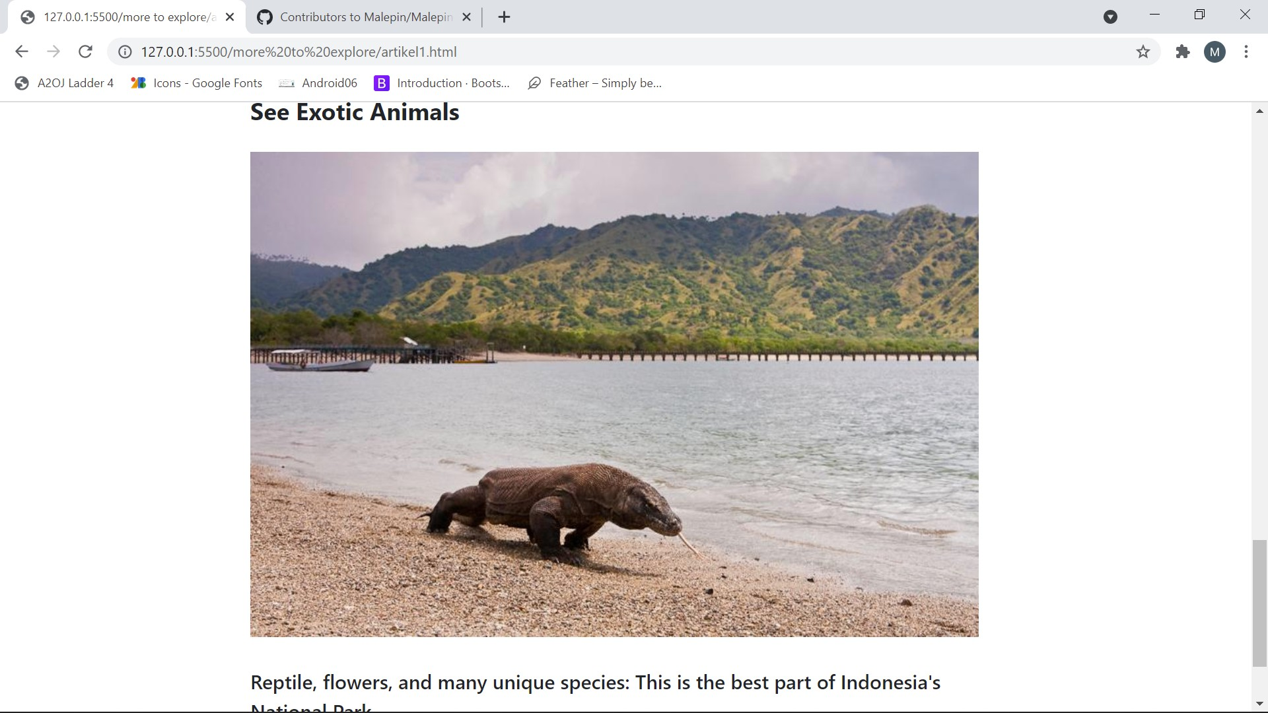
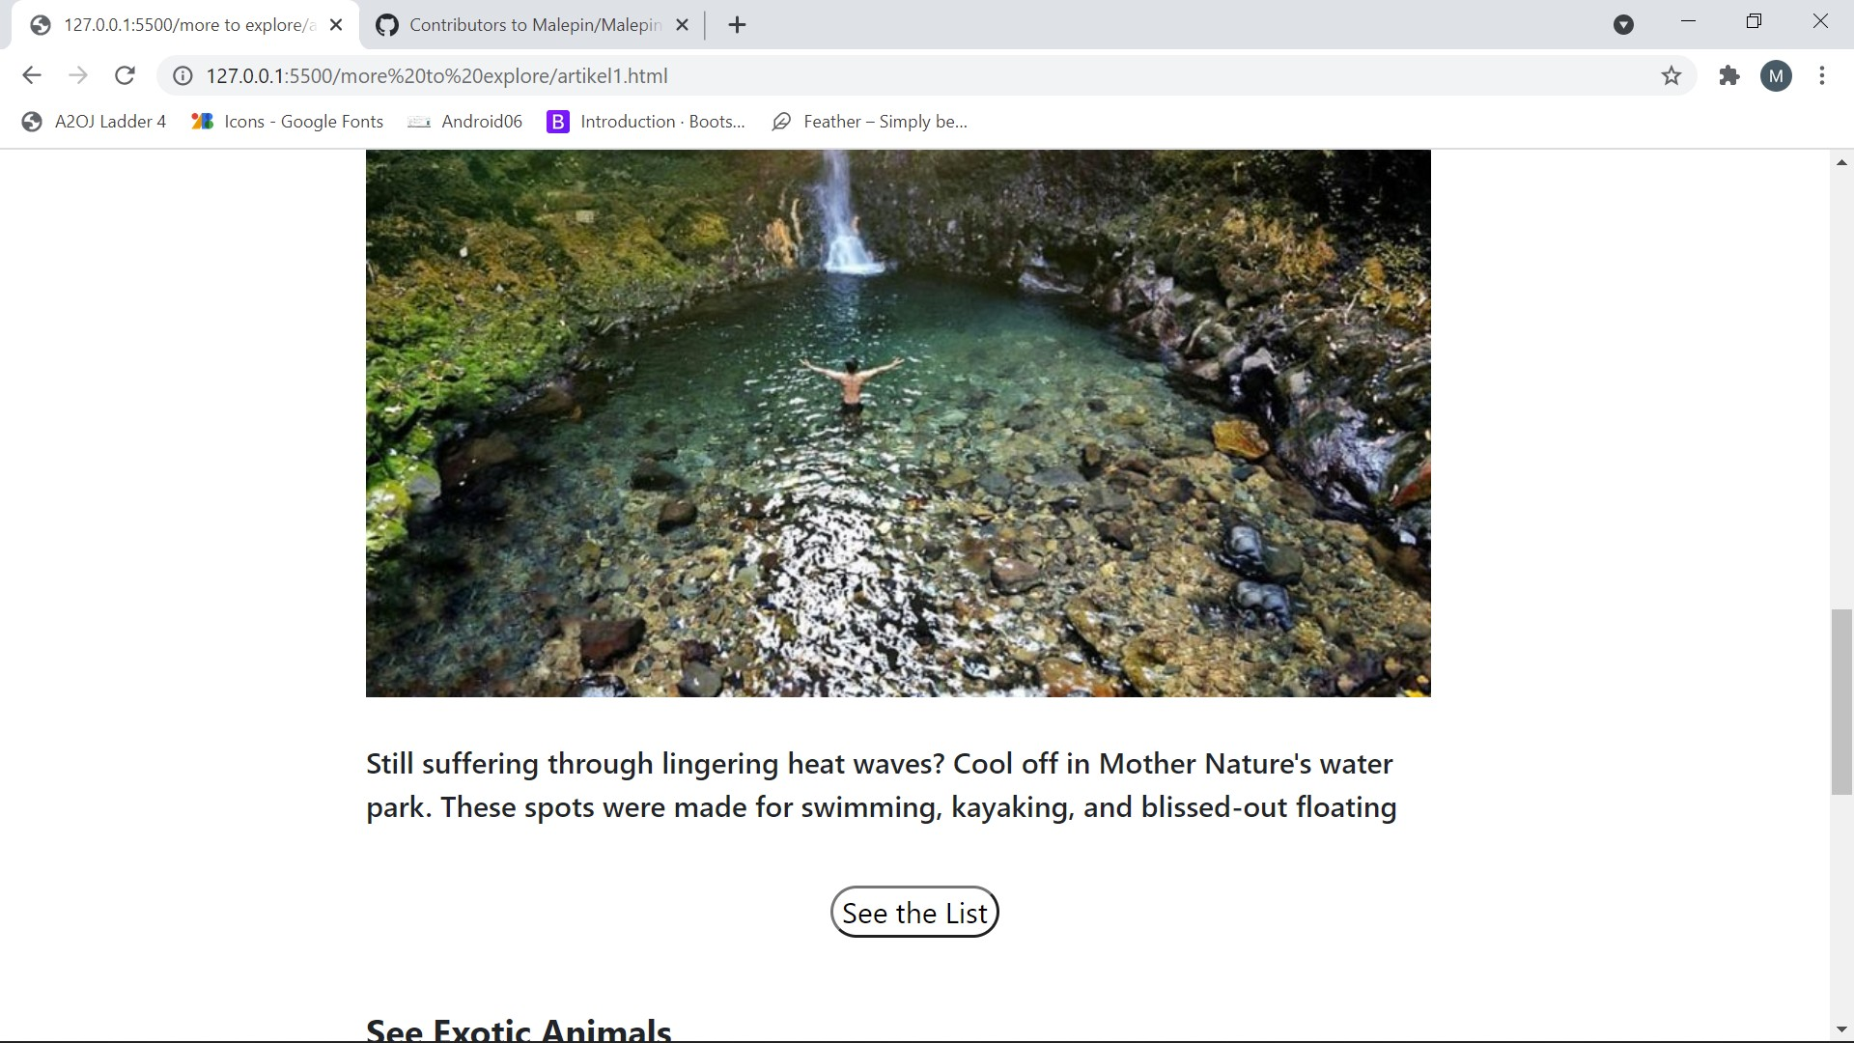
Isi artikel
Design Akhir

Slide 24
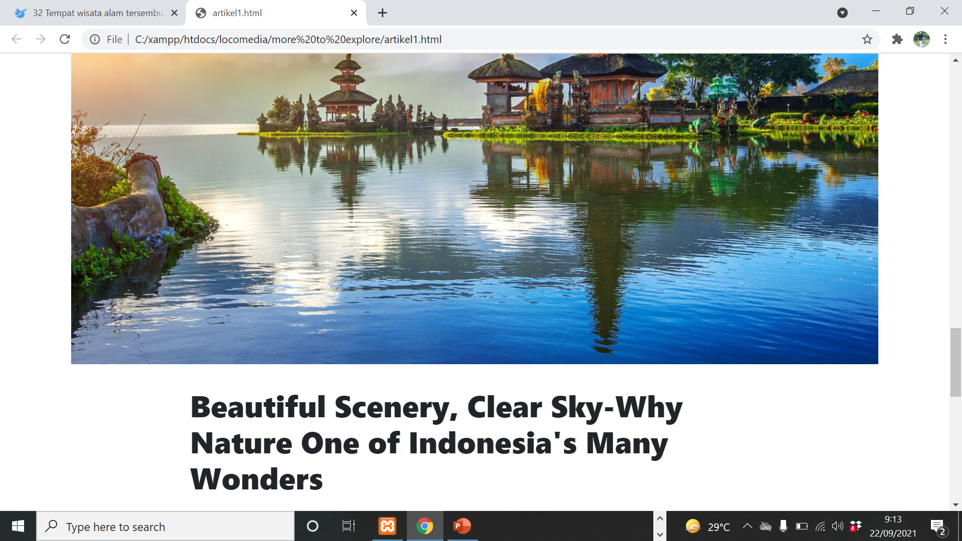
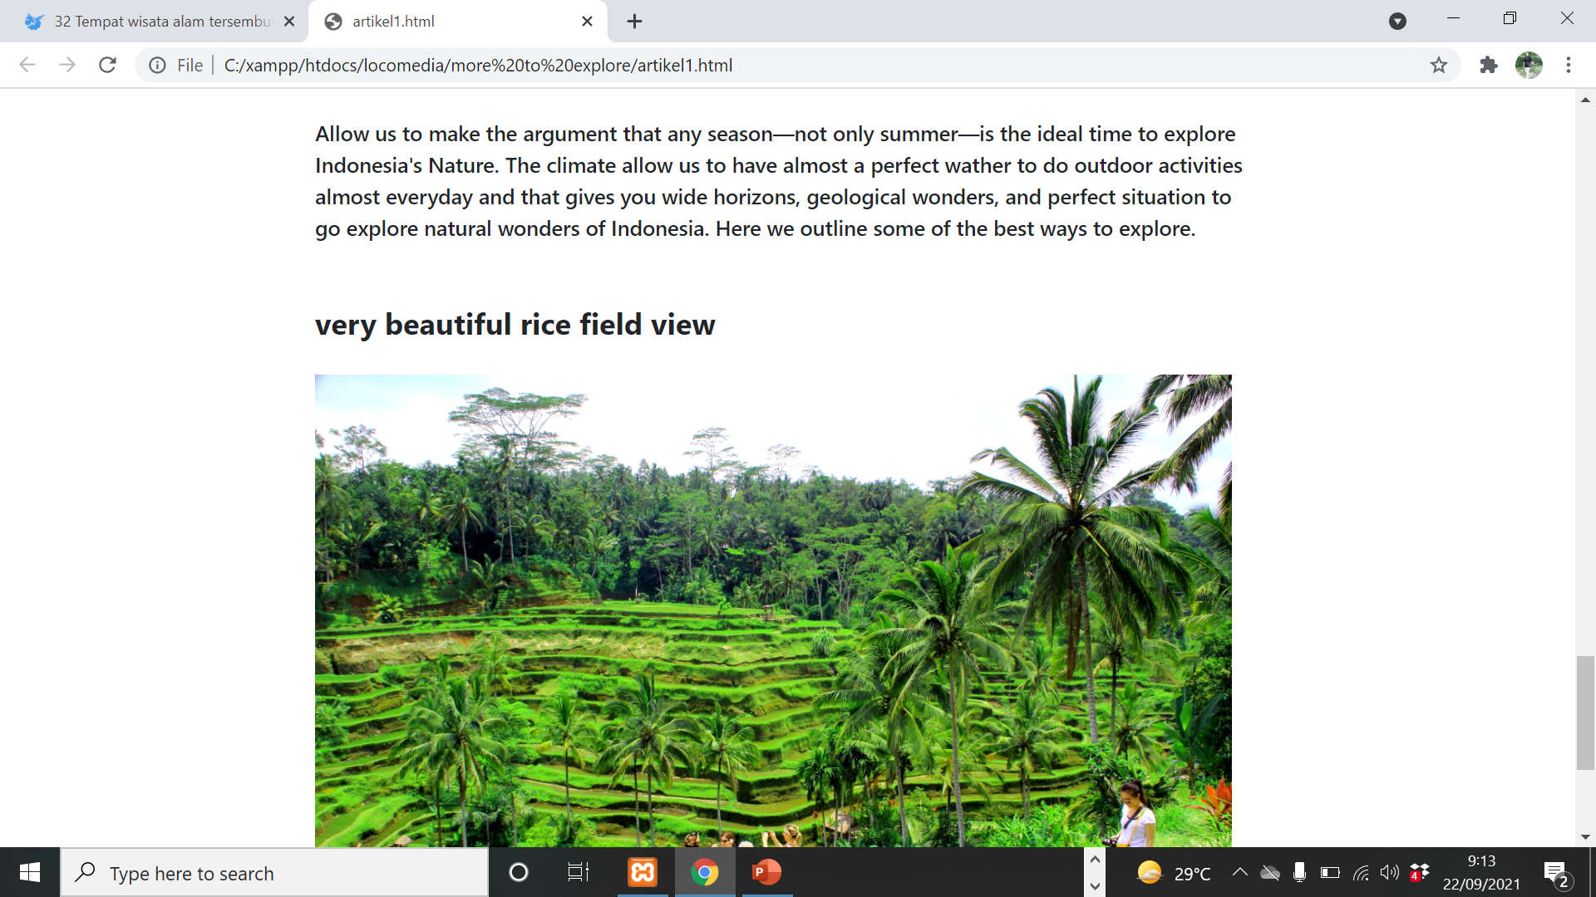
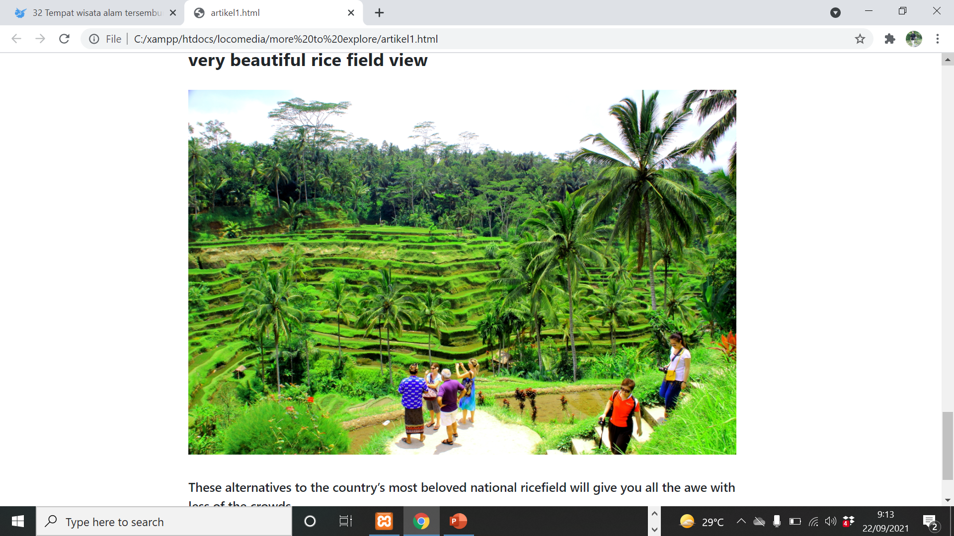
Isi artikel
Design Akhir

Slide 25

sponsor
Design Akhir

Slide 26

footer
Design Akhir

